Slide 1


The Stock Market Game

Slide 2
AGENDA
SMG Overview
Rules and Goals
Getting to Know the SMG Student Portfolio
Investing Basics
Stock Research and Tips
News and Events in SMG
Notes:
Slide 2: Agenda
(This slide has animation and will highlight Section A when you click).
Provide students with a brief overview of what will be covered.
Optional:
Share a personal (or client) story about Investing with the students.
Optional:
Ask students if there is anything specific they’d like to learn about Investing.

Slide 3

Notes:
Ask Students: Any questions about SMG right away that you want to make sure we talk about?

Slide 4

SMG Overview
Teams of 2-5 students
$100,000 of virtual money to invest
Access your portfolio at www.stockmarketgame.org
Buy and sell securities as often as you like!
  Security: A financial instrument representing ownership (stock, bonds, mutual funds)

Slide 5
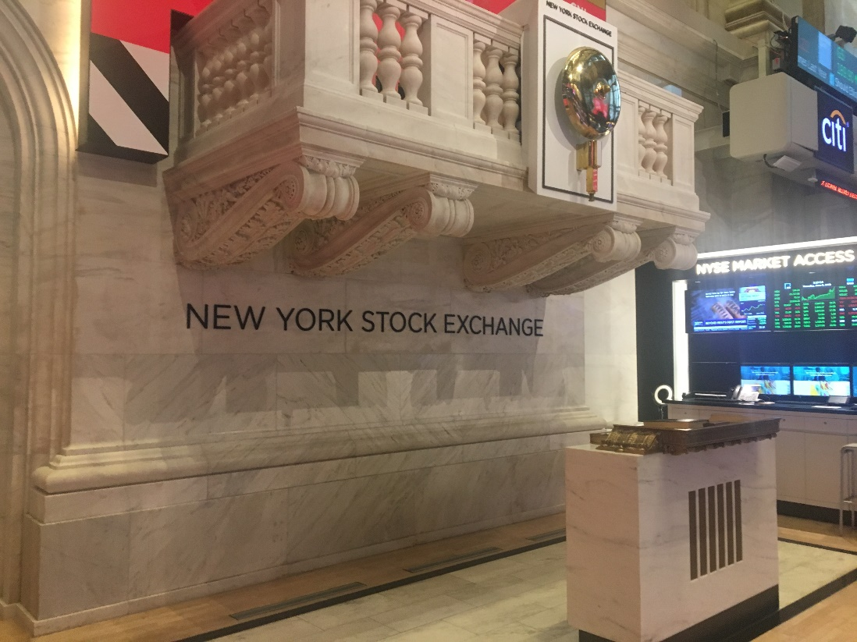
SMG Overview
Students can purchase securities on two stock exchanges:
New York Stock Exchange (NYSE): The oldest exchange, largest, and best-known exchange, with more than 3,500 companies listed.
www.nyse.com
NASDAQ: The second largest exchange, behind NYSE, with more than 3,000 listings.
www.nasdaq.com
Learn more about the two exchanges here.

Slide 6
SMG Rules
You can spend up to 20% of your portfolio
on one stock
Minimum number of shares of stock to buy: 10
Negative cash balances are charged 7% annual interest (charged weekly)
Positive cash balances accrue 0.75% interest annually (credited weekly)

Slide 7
SMG Rules
Stock transactions are in real time
  Important to note: your portfolio numbers will not update for one business day
Trades entered when the market is closed will be priced and finalized at the opening of next business day
Market Hours: 8:30 a.m. – 3:00 p.m. (Central Time)

Slide 8
SMG Rules
Cannot trade anything priced at $3.00 per share or lower
Trades will be rejected if sufficient buying power does not exist
  No single trades worth more than $30,000
  No spending more than $150,000

Slide 9
SMG Rules
$5 flat broker’s fees for all transactions
(buy, sell, short sell, short cover)
Mutual funds are priced once per day
Dividends and splits are automatically computed into student portfolios

Slide 10
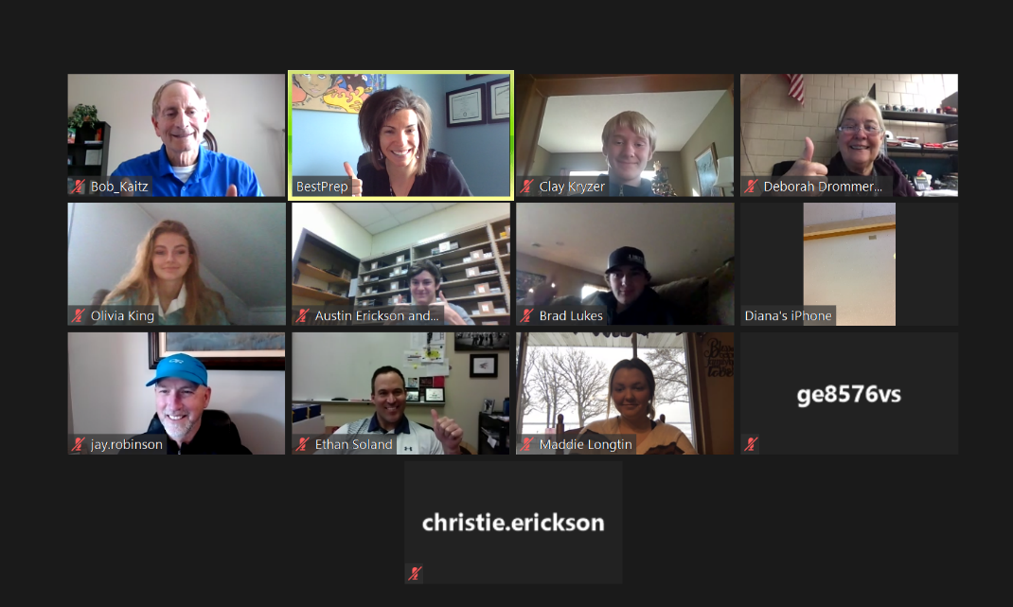
SMG Overview
You’re participating in a competition!
  Students compete
  against all teams
  playing in the same
  session, in the same
  age division
  Winning teams are
  determined based
  on the highest-valued portfolio at the end of the session

Slide 11
Notes:
PAUSE HERE FOR QUESTIONS!
ASK STUDENTS - WHAT DO YOU ALREADY KNOW ABOUT INVESTING AND THE STOCK MARKET?
Via chat: Have students name things that can rise in value, why would investing be important?
Optional:
Ask the students to brainstorm why investing might be important. What are reasons they would want to invest? What might investing help them do?
The reason to accumulate money is so you don’t have to worry about money. It’s sort of like health. It’s only when you’re sick that you realize how great it is to feel healthy. Similarly, it’s only when you don’t have enough money that you realize how great it is to be on a solid financial footing. More money may not make you happy—but not having money could make you extremely unhappy. You want to get to the point where money isn’t something you worry about.
This may mean saving like crazy. And, no, you won’t be missing out on much. All those possessions you want will give you so little pleasure. Instead, what will give you pleasure is striving after the things you’re passionate about. I would encourage you to manage your financial life so you can do just that.
Understanding the basics of investing is one tool for your future as you become more independent with your spending and saving habits.
DEFINITION FOR INVESTING
Optional:
Have a few students give their definition of investing and/or saving.
Optional:
Ask students to list off investments they know.
Some items to include would be stocks, bonds, mutual funds, antiques, art (paintings, sculptures, etc.), collectibles, real estate, sports memorabilia, education, etc. Some other items that may be of interest to students would be certain types of cars, etc.
Remind students that to consider these things as investments they must be willing to sell them, and they must have the potential to increase in value.
Investing is spending money on something with the expectation of a future return or benefit. Remember, though, returns are not always guaranteed.
Investing is an opportunity to get more than face value out of your money if done responsibly.

Slide 12

Investing Overview
INVESTING: To set aside money in the hope of a future return or benefit
WHY INVEST?
To help meet longer term goals and financial plans
To help beat inflation and maintain preferred lifestyle
To gain greater financial independence and sense of security
Notes:
Slide 5: Why Should You Invest?
Why should you invest the money if you don’t need it in the near term?
Start saving for financial freedom and retirement: I am defining financial freedom as having the financial resources that allow you to make choices. You have an opportunity for a new, better job—maybe self-employment; do you have the financial resources to make the transition? What was once your dream job has turned into a nightmare; do you have the financial resources to support yourself as you look for a new job? If you have significant savings for retirement, it provides you with the freedom to make more risky decisions that might just pay off for you. I know, I know, retirement seems like forever from now. But it’s more important than ever for us to focus on this savings goal as soon as possible. We will discuss the power of compounding later. The earlier you start, the greater the compounding effect.
Meeting long term goals: Grow your money to be able to meet long-term goals more quickly.
Beat Inflation: You want to beat inflation because you want to at least match and hopefully exceed changes in the cost of living. For Example, you have $10,000 to set aside to spend in five years. At 3% inflation, what you would have bought with the $10,000 today will cost $11,593 in five years. You want to earn more than the 3% rate of inflation so you be able to at least buy what you could have bought today in five years. Ideally, you would have some left over if your investment returns exceeded the rate of inflation.
Optional:
Provide a case study or personal example. How did investing early help you or a client? Did it change your/their habits in the short-term? How did short-term successes help add to the long term goal of investing?

Slide 13
Save or Invest?
SAVE for short-term goals (less than 5 years)
INVEST for long-term goals (more than 5 years)
You are just out of college and want to set money aside for retirement
You want to go on a week-long vacation or road trip with friends
You have a child and you want to put money away for her to go to college
You want to buy a guitar signed by your favorite musician
Notes:
Saving vs. Investing
What is the difference between saving and investing?
CHAT IN: students’ short term and long term goals
What are some of your short-term goals (one-month, one-year, by high school)?
What are some of your long-term goals (college, car, career plans, etc.)?
ASK students to “raise their hand” or put in chat if they are already saving money. Does anyone have savings accounts in a bank?
Savings accounts are great and the money is easily accessible, which is great for short-term goals. You likely won’t earn much interest.
Have students put in chat what they are saving for (clothes, toy/game, electronics, ticket to an event, something for the family, etc.)
Have students think about their longer-term goals:
Something they’d like to buy, do or accomplish within the next 5 to 15 years?
What do they think their goals will be when they are older/What are their parents’ goals?
Investing can help them have the money to achieve those goals!
As each bullet point pops up ask the students to put into chat if they think they would save for this goal or invest for this goal.
This brief activity is a great chance for students to engage with the speaker and the material being covered. This is also a great method to check for understanding. Feel free to switch out the examples of saving vs. investing – be humorous or serious with your examples as long as they actually make sense and support the idea of saving vs. investing.
Answers: Invest, Save, Invest, Save - These are the generally accepted answers, but if students disagree, encourage discussion and ask them why they chose the other option.

Slide 14


Time and the Power of Compound Interest
Both Tim and Mai have a goal of saving $100,000 in the next 18 years
Both earn a 7% annual rate of return
Tim begins saving now, and Mai begins saving in 10 years
The following example is a hypothetical, for illustrative purposes only, and is not indicative of any investment.
Notes:
Slide 12: Time Is On Your Side: Compounding
Compounding is the ability of an asset to generate earnings, which are then reinvested in order to generate their own earnings. In other words, compounding refers to generating earnings from previous earnings. Compounding can significantly boost investment returns over the long term.
<The example setup is on the slide.>
Ask Students: How much more will Mai have to save each year than Tim? How much total?

Slide 15
Time is on Your Side:
Compounding Interest
Annual Savings
Total Amount Saved Compared to Earnings
Notes:
Slide 13: Time Is On Your Side: Compounding, Part 2
Because Tim started 10 years earlier, he only had to save $2,749 per year ($229/month) while Mai had to save $9,109 per year, more than three times as much as shown in the left chart. Although Sally saved for a shorter time, she had to save a lot more in total than Tim, $72,870 compared to Tim’s $49,480 shown on the right chart--in both cases, the hypothetical 7% earnings on the savings brought the total to $100,000. See how much harder earnings will work for you if you give them more time?

Slide 16


What Can You Invest In?
Stocks
Mutual Funds
Bonds
Notes:
Slide 14: What Can You Invest In?
An investment, in the financial sense, is an asset purchased with the expectation that it will either provide income in the future or appreciate and be sold at a higher price, or both. An asset is a resource with economic value that one owns or controls with the expectation that it will provide future benefit.

Slide 17
Stocks
Stocks represent ownership interest (equity) in a company and the company’s assets and earnings
When a company grows, stockholders often receive the biggest portion of the gains
If the company does not grow quickly, stockholders are the last people to get paid--they may even lose money if the company is not successful
Notes:
Buying Stocks as an Investment in SMG – most popular type of investment in the game!
Stocks are a very popular investment!
It’s important to do research before you decide which stocks are right for you.
-----------------
A holder of stock (a shareholder) has a claim to a part of the corporation's assets and earnings. In other words, a shareholder is an owner of a company. Ownership is determined by the number of shares a person owns relative to the number of outstanding shares. For example, if a company has 1,000 shares of stock outstanding and one person owns 100 shares, that person would own and have claim to 10% of the company's assets.
Stocks are the foundation of nearly every portfolio. Although past performance is not indicative of future results, historically, they have outperformed most other investments over the long run.

Slide 18
Investing, Managing Risk, and Diversification
What is risk?
Risk is the potential for loss and is associated; in the case of investing, it’s the potential loss of part or all your investment’s value
Snow
Blowers
Lawn
Mowers
Winter Spring Summer Fall
Notes:
Slide 18: Managing Risk: Diversification
You have several investment options in SMG – stocks, bonds, mutual funds – but stocks are the most popular.
[This slide is animated and will show a blue line in the middle upon clicking]
Companies (like Toro) reduce risk by developing several products for a variety of uses, seasons of the year, or parts of the country or even world. This results in more reliable earnings (which is what drives stock prices to positive returns).
If Toro sold only snow blowers, what would its’ sales look like? Would you want to own its stock?
Optional:
Ask the students if they can think of any other companies that diversify their risk? Polaris is another example.
Investors can use diversification in investing as well. The idea is that when one investment is not performing well, another may pick up the slack. So instead of owning just large companies, you can own large, mid, and small companies in U.S. and foreign countries, and mix in bonds as well. The theory is that over time you will see a smoothing of your returns.
Diversification does not guarantee investment returns and does not eliminate the risk of loss.

Slide 19
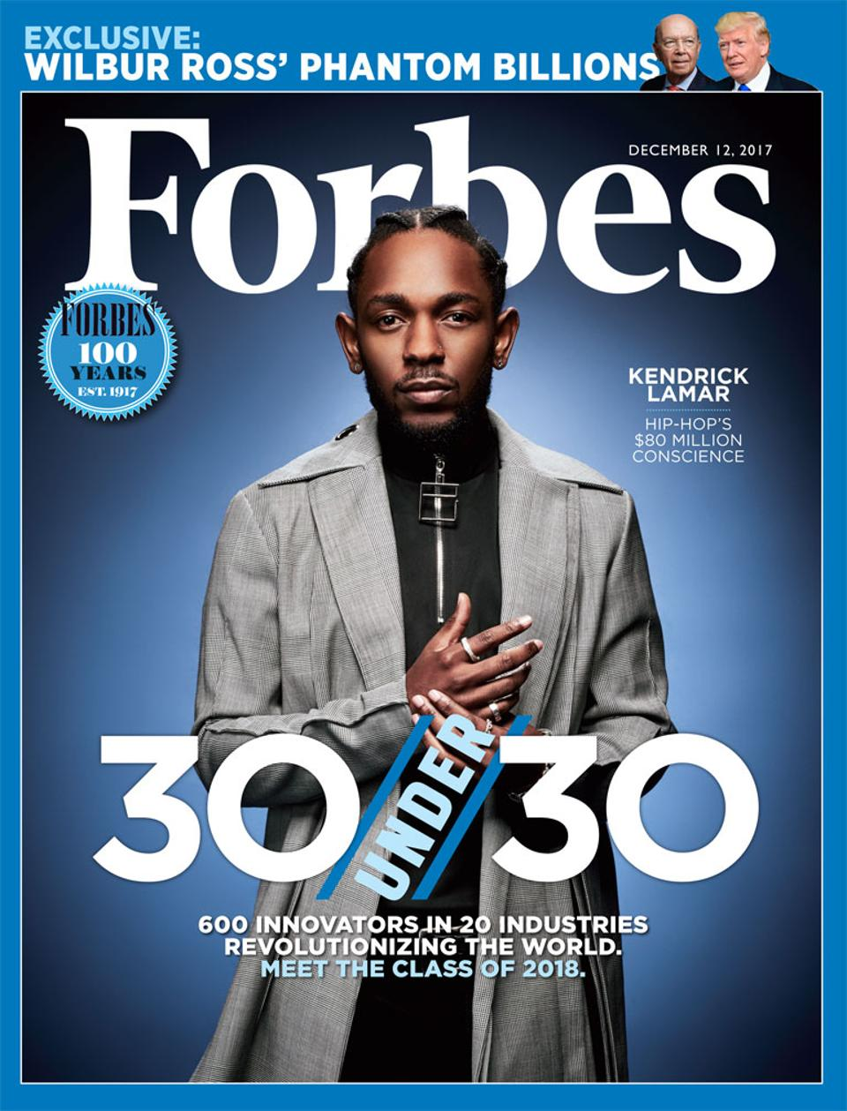
Researching Stocks
Why do research?
Where to research
  Investopedia
  Wall Street Journal
  Yahoo! Finance
  Company website
Notes:
Why should you research companies and review market trends before buying a stock, or selling?
What research have you already done?
Researching companies can help you understand how they might perform and any trends you may find. It keeps you informed and you learn more about the investments you’re making!
Where to do research:
Investopedia, Wall Street Journal, Yahoo Finance
Visit companies’ websites to see what products/updates they’re sharing
Google the company to see what other news is circulating about a company →
The importance of News and Current Events in SMG!

Slide 20



Research and Stock Tips
Research Tips
  Past and present growth?
  New products and services? Competitors?
  Current president/CEO?
Choosing Stocks
  “Familiarity”
  “Popularity”
  Read between the lines!
  Diversify
Notes:
Research and Stock Tips!
Past performance – how did the company do a year ago? Any seasonal relationships (summer vs. winter?)? How have they been doing this year?
Does your company have new products or services, or a new invention? Are new products and services supposed to be popular?
STOCK TIPS FROM TRAVELERS – Investment Analyst shared these tips at our Fall Awards Ceremony:
Avoid familiarity – just because you know the brand or company doesn’t mean the company’s stock is performing well
EXAMPLE – who’s heard of Starbucks? Their stock was down the past few months.
Avoid investing for “popularity” – just because you know a company is popular or well-known doesn’t mean the stock will be doing well – just do your research
EXAMPLE – Under Armour – popular brand, but stock was down all year
Read between the lines! Amazon example – what does Amazon do? Send packages. What company might benefit from all those packages being sent?
The importance of News and Current Events in SMG!

Slide 21


News and Current Events
Following the news and current events is an important part of investing!
Good Press vs. Bad Press
Current Events: What’s
happening locally, nationally,
and globally?
Notes:
The importance of News and Current Events in SMG!
Variety of ways news and current events can impact stock pricing and performance
News outlets share important updates on progress or changes within companies (TV, digital news, newspapers, magazine articles)
Depending on the type of stories shared, this can be considered “good” or “bad” press
WHO KNOWS WHAT GOOD AND BAD PRESS IS?
Example: a company donates a large sum of money
Example: a company is called out for bad customer service
Example: Chipotle, Airlines and passengers, Samsung, Frozen Movie performing well
Review a company’s performance and see if it relates to any media/news attention it’s received!
Current Events
Natural disasters – how it affects companies’ performance – recent snowstorm (snowblowers, snow equipment, snow sport equipment), hurricanes this past summer
Company mergers – one company buys another
Social trends – Use Amazon example! (packaging materials)
Things happening in the government (tax reform, health care, education, etc.)

Slide 22

Final Tips
Take risks, but not excessive risks
Do your research
Diversify, diversify, diversify
Use resources/get advice
Notes:
Slide 22: Final Tips
Some calculated risk-taking is warranted in order to gain a potentially greater return, especially if your time horizon is long. However, some risk is not worth the potential additional return. Taking additional risk without a reasonable expectation of being compensated for that risk is akin to gambling. Be sure to understand the various methods of managing risk.
Optional for presenter:
Include resources and examples that would be relevant for a high school student to use if they wanted to continue to learn about investing after the presentation. (For example, the FPA or CFP website, relevant blogs, Investopedia.com)

